Slide 2
Windows IoT Core Tips & Tricks in .Net
Juan Manuel Servera
Developer eXperience
@jmservera – juanserv@microsoft.com

Slide 4
Agenda
IoT Core Basic Knowledge
C# vs C++ performance
Microseconds in C# without going nuts
Bluetooth Stack
Analog Output with PWM
Connecting to the cloud

Slide 5
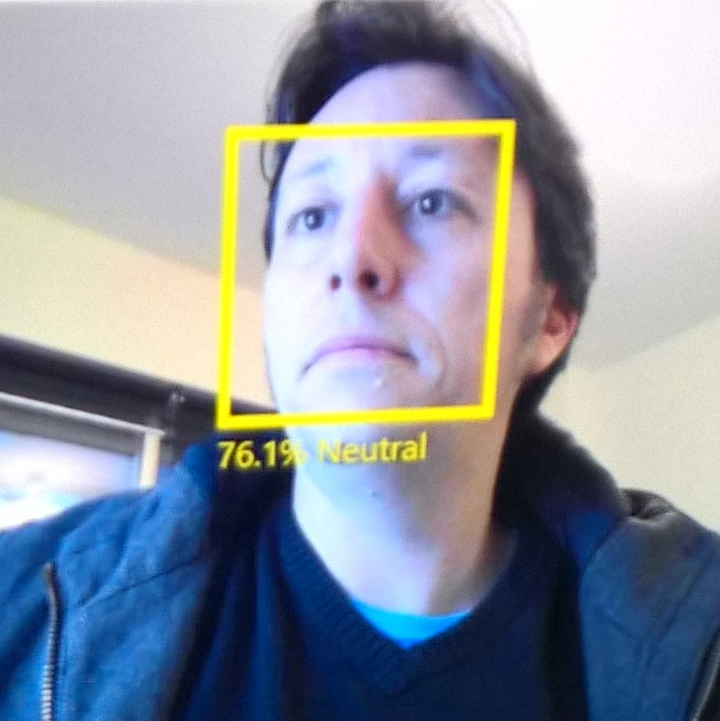
Juan Manuel Servera
Father of two
Undiscovered guitar player
.net Developer since v1.0 beta 2
C# MVP in 2014 & 2015
Level 44 geek
juanserv@microsoft.com
@jmservera

Slide 6

Choosing the right gift is not always easy

Slide 7
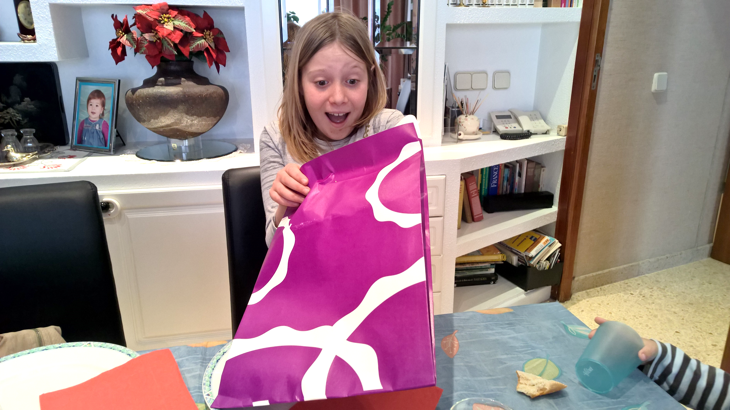
Sometimes you get it right

Slide 8
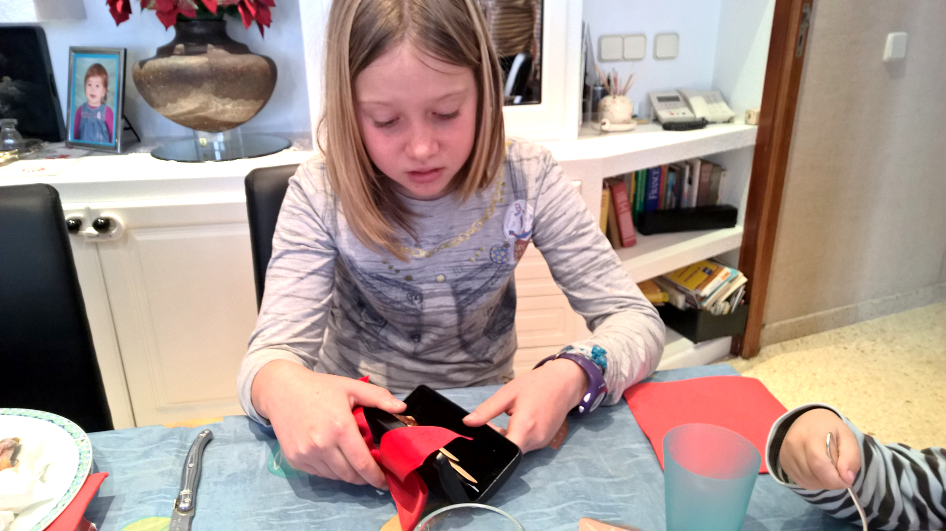


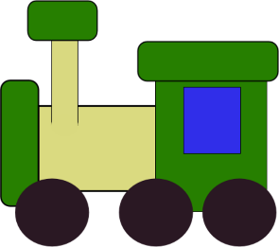
Occasionally you don’t…
10%
62% Clothes
18%
Donation
15%
Re-gift
16% Toys
11%
Throw it
6%
Resell it
Notes:
http://www.inquisitr.com/172501/the-most-returned-christmas-gifts-46-billion-in-clothes-electronics-and-jewelry-head-back-to-the-store/
http://www.cnbc.com/2015/12/28/your-holiday-gift-returns-cost-retailers-billions.html

Slide 9
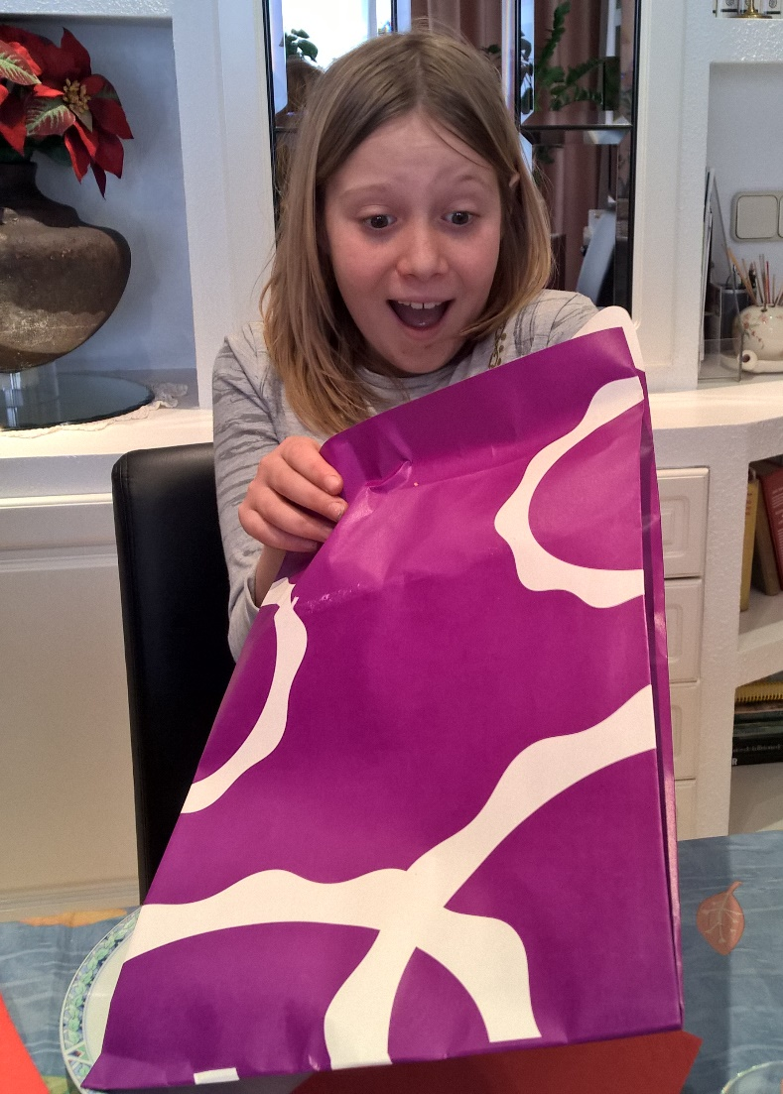
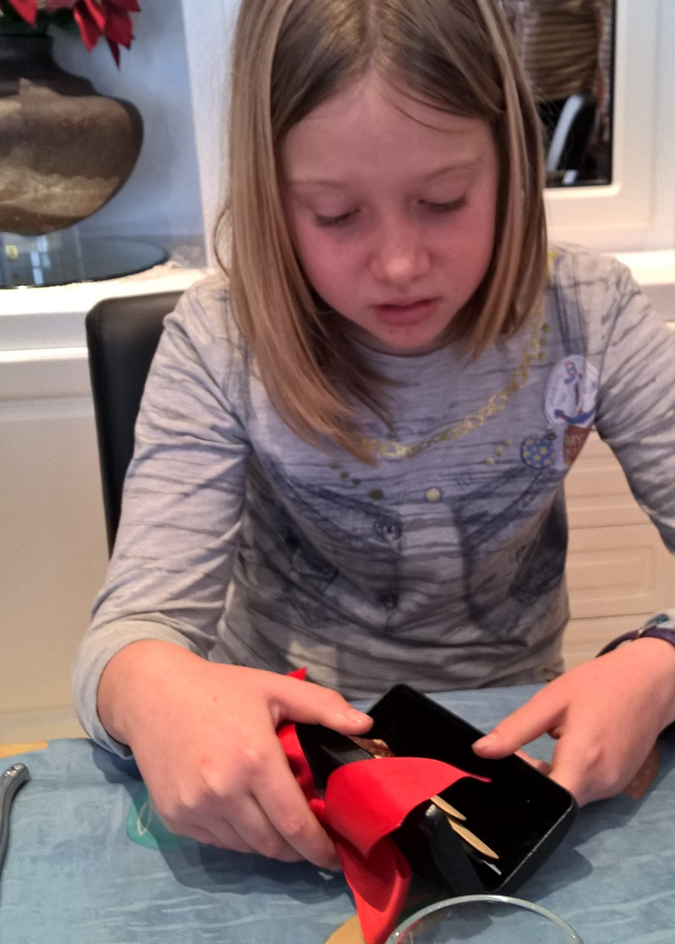
What if you could measure the happiness of a gift?
Happiness: 65%
Surprise: 35%
Neutral: 71%
Sadness: 29%

Slide 10
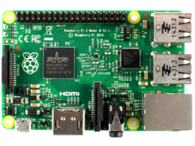
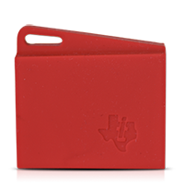

Connected Christmas Tree (spoiler alert ☺)
ACME

Slide 11
Connected Christmas Tree (spoiler alert ☺)
ACME

Slide 12
Demo
Notes:
Helpful: http://www.digikey.es/en/resources/conversion-calculators/conversion-calculator-resistor-color-code-4-band

Slide 13
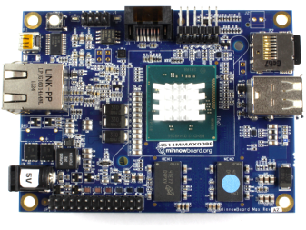
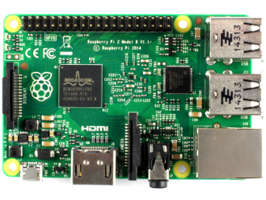
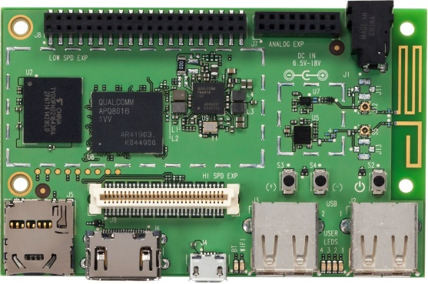
Windows 10 IoT Core

Slide 14
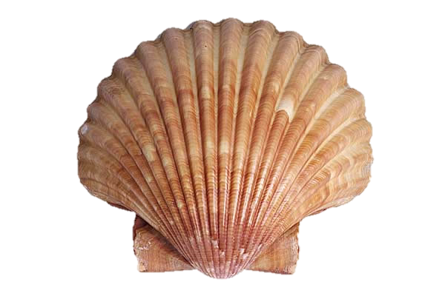
IoT Core Basics

Slide 15
Demo Windows 10 IoT Core

Slide 16
Demo
Connect the RPi2 and show the UI
Connect to the RPi portal and show no explorer.exe
Open VS and create a headless app
Open VS and create a headed app

Slide 17
C# vs C++ performance in UWP
Source Code
Language Compiler
App.exe (MSIL)
.NET Native
(ILC.exe)
App Package (Native assembly)

Slide 18
.Net native
Benefits
No JIT + lean runtime means startup is lightning fast
60% faster startup
Lower memory usage (~40% lower)
Pains
Longer build times
Larger binary size
Ahead of time “complications”
Growing pains of a “v1”

Slide 19
Can you wait/measure Microseconds (µs) in .Net?
C++
QueryPerformanceCounter
.Net
StopWatch
Elapsed.TotalSeconds
Task.Delay(
TimeSpan.FromTicks(100))

Slide 20
Microseconds, C++ vs C#
GpioPinValue value = this->pin->Read();
if ((previousValue == GpioPinValue::High) && (value == GpioPinValue::Low)) {
// A falling edge was detected
LARGE_INTEGER now;
QueryPerformanceCounter(&now);
if (i != 0) {
unsigned int difference = static_cast<unsigned int>(
now.QuadPart - prevTime.QuadPart);
Reading.bits[Reading.bits.size() - i] =
difference > oneThreshold;
}
prevTime = now;
++i;
}
GpioPinValue value = pin.Read();
if ((previousValue == GpioPinValue.High) && (value == GpioPinValue.Low))
{
// A falling edge was detected
// Calculate the microseconds in a fractional second
long now = (long)(stopwatch.Elapsed.TotalSeconds * 1000000);
if (i != 0)
{
var difference = now - prevTime;
bits[bits.Length - i] =
difference > oneThresholdMicroseconds;
}
prevTime = now;
++i;
}
(µs) microseconds

Slide 21
Demo Microseconds

Slide 22
Performance hints
Do not allocate objects
Change the GC LatencyMode to LowLatency
Embrace Timeout Errors

Slide 23

Testing what we’ve done so far

Slide 24
Demo Simple Web Server

Slide 25
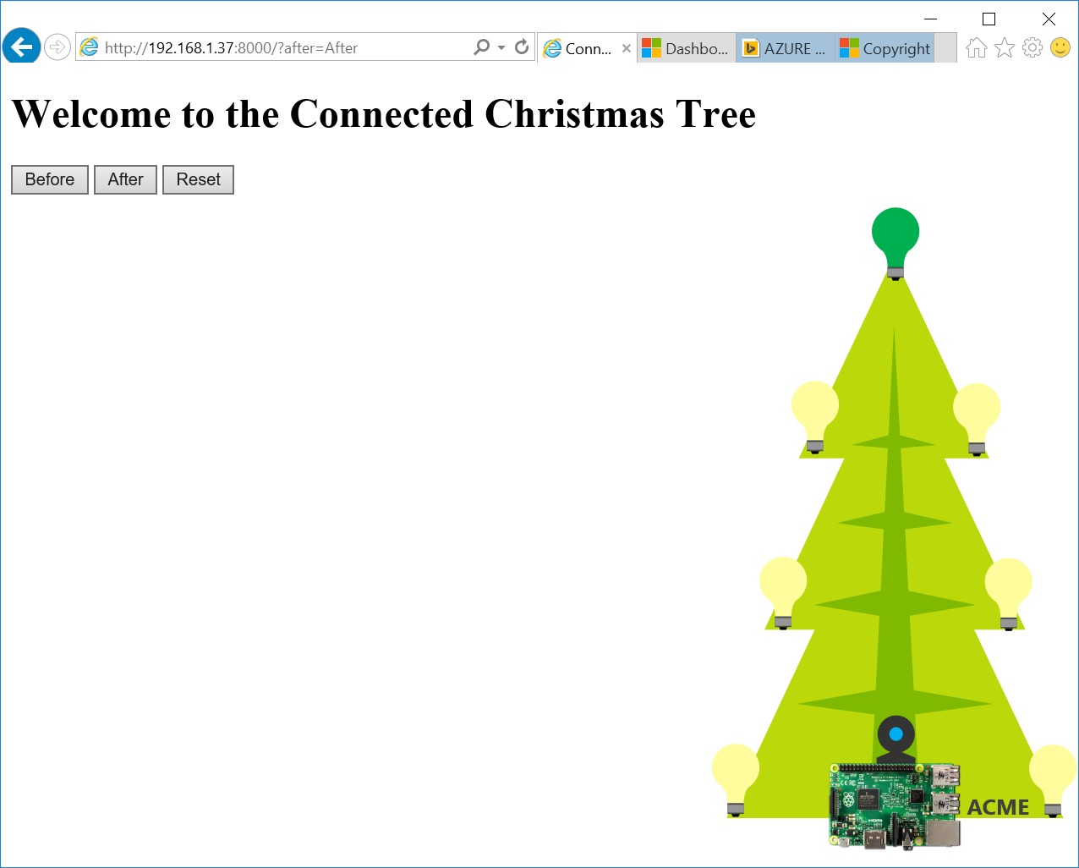
Demo: show the cct custom portal

Slide 26
Connecting crazy Bluetooth sensors
Peripheral
Service
GattDeviceService
Characteristic
GattCharacteristic
Attribute
CharacteristicValue
Attribute
CC2650
light, digital microphone, magnetic sensor, humidity, pressure, accelerometer, gyroscope, magnetometer, object temperature, and ambient temperature
Characteristic
Attribute
Attribute

Slide 27
Demo Bluetooth LE

Slide 28
RGB Lights

Slide 29
Digital to Analog conversion
01001010001101010001100100110001
01100010010100011010100011001011
10101000110010101010001100101111
11010010010100011011110100011010
01100010010100011010100011001011
01001010001101010001100100110001
01100010010100011010100011001011
10101000110010101010001100101111
11010010010100011011110100011010
11010010010100011011110100011010
01100010010100011010100011001011
01001010001101010001100100110001
01100010010100011010100011001011
10101000110010101010001100101111

Slide 30
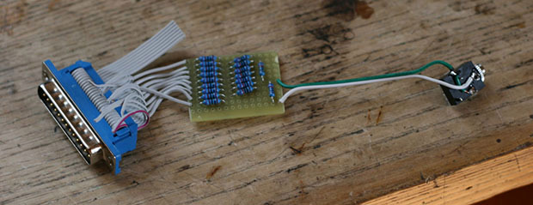
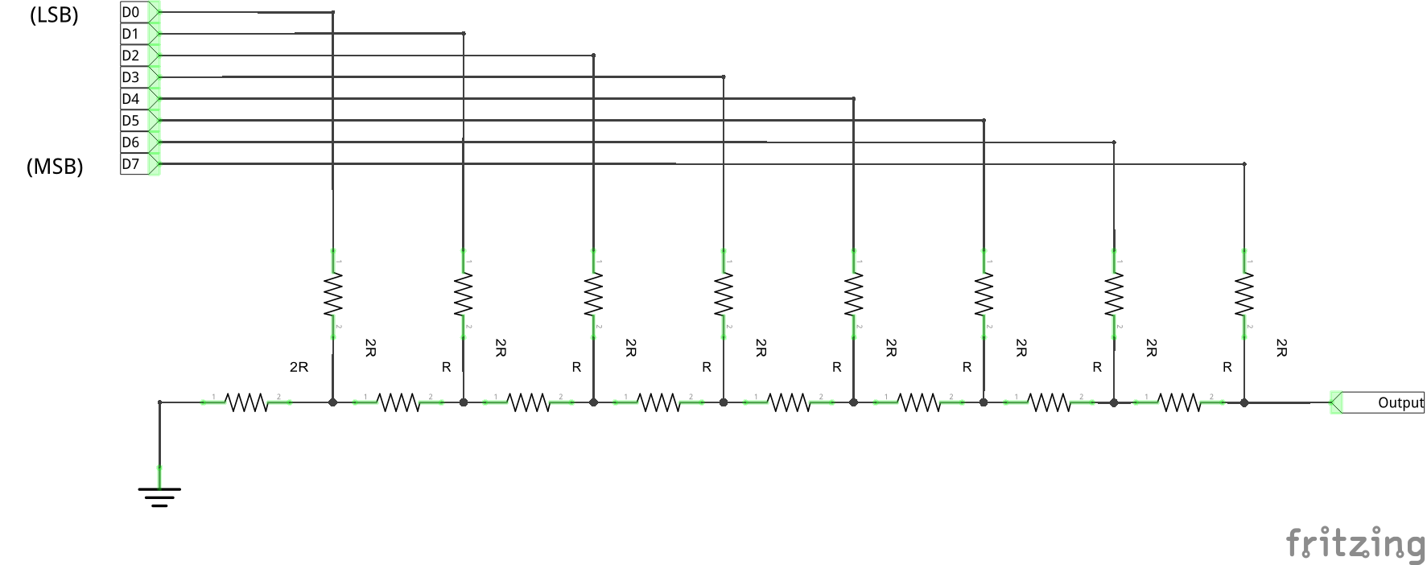
DAC the old hardware guy style

Slide 31
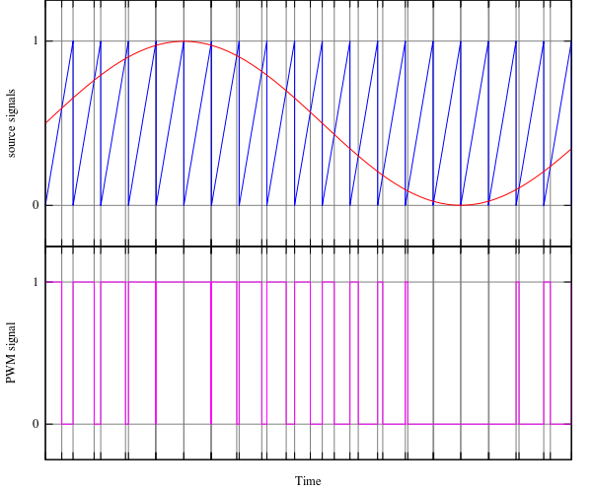
DAC the Developer’s style
PWM by software
Source: Wikipedia

Slide 32
Demo PWM

Slide 33
How do we communicate with a device?
Telemetry
Registration
Security
Notifications
Monitoring

Slide 34
IoT Hub
Designed for IoT
Connect millions of devices to a partitioned application back-end
Service assisted communications
Devices are not servers
Use IoT Hub to enable secure bi-directional comms
Cloud-scale messaging
Device-to-cloud and Cloud-to-device
Durable messages (at least once semantics)
Cloud-facing feedback
Delivery receipts, expired messages
Device communication errors
Per-device authentication
Individual device identities and credentials
Connection multiplexing
Single device-cloud connection for all communications (C2D, D2C)
Multi-protocol
Natively supports AMQP, HTTP
Designed for extensibility to custom protocols
Multi-platform
Device SDKs available for multiple platforms (e.g. RTOS, Linux, Windows)
Multi-platform Service SDK.

Slide 35
Demo IoT Hub
Notes:
{userPresent:true,date:'2016-01-01T10:00:00', heartrate:'25.5',stage:0, emotion:'sadness',score:85}

Slide 36
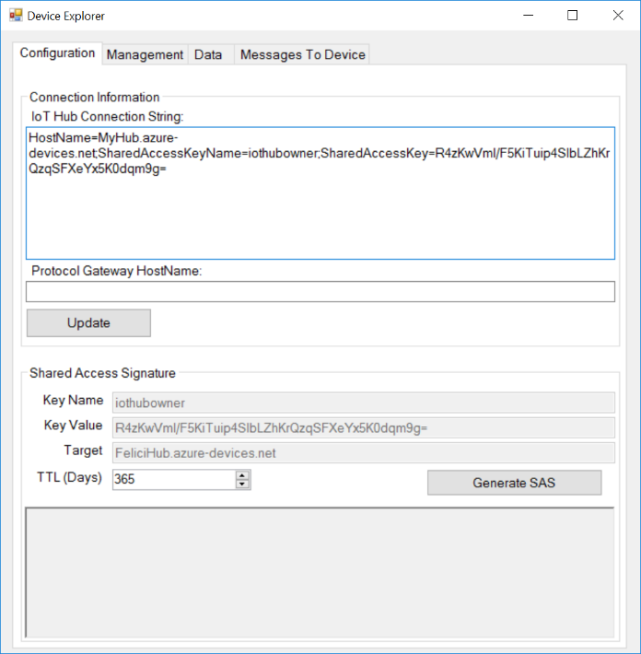
IoT Hub Explorer
Notes:
Send {measurename:'x', emotiondatedate:'2016-01-01T10:00:00', heartrate:'25.5',sessionid:'1',stage:0, emotion:'happiness',score:85} to the tree and see what happens ☺

Slide 37
Key findings
Most people are analog for I/O
Embrace errors when reading sensors
C++ for performance not always required
Software simulation may be acceptable in most cases
We can find the right gifts ;)
Notes:
Find a cylon picture

Slide 38
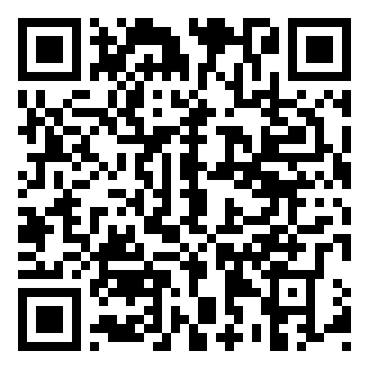
http://aka.ms/DOTNETT8S2
https://github.com/jmservera/ConnectedChristmasTree
https://github.com/jmservera/IoTHubDemo
https://github.com/jmservera/rgbled

Slide 39
Juan Manuel Servera
Developer eXperience
@jmservera – juanserv@microsoft.com
http://aka.ms/DOTNETT8S2

